Slide 1
22CS014
Front End Engineering-II
Project Name: WELLSTAY
Submitted by:
Devanshi Dadwal 2210990262
Dikshant Sohal 2210990283
Dipankar Sethi 2210990287
Diyanshi Gupta 2210990305
Submitted to:
Shalini Kumari
Department of Computer Science and Engineering
Chitkara University, Punjab

Slide 2

Introduction
Wellstay features a online system in which guests and hosts can check the online housestays. It is operating an online marketplace for homestays and experiences. Airbnb is an online marketplace that connects people who want to rent out their property with people who are looking for accommodations, typically for short stays. it is a unique business model, innovative use of technology.

Slide 3
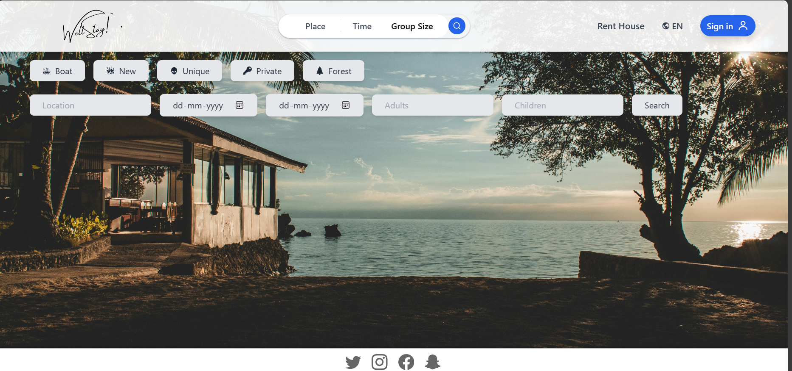
Visuals
.
.
This is the front page of our website which requires the details like location, check-in, check-out details etc.

Slide 4
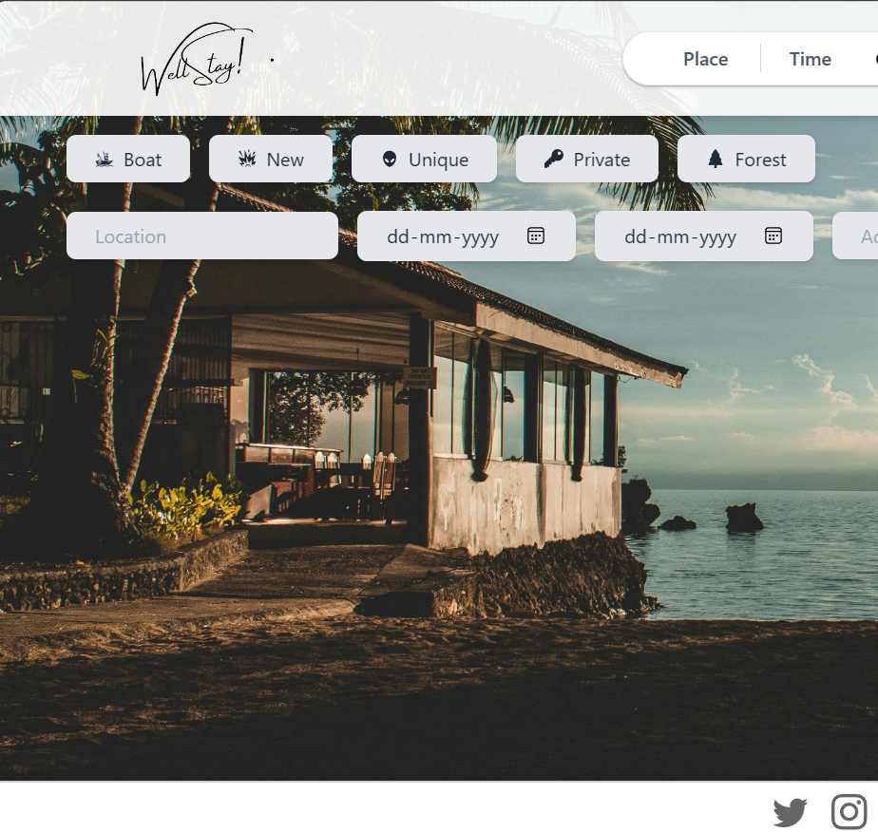
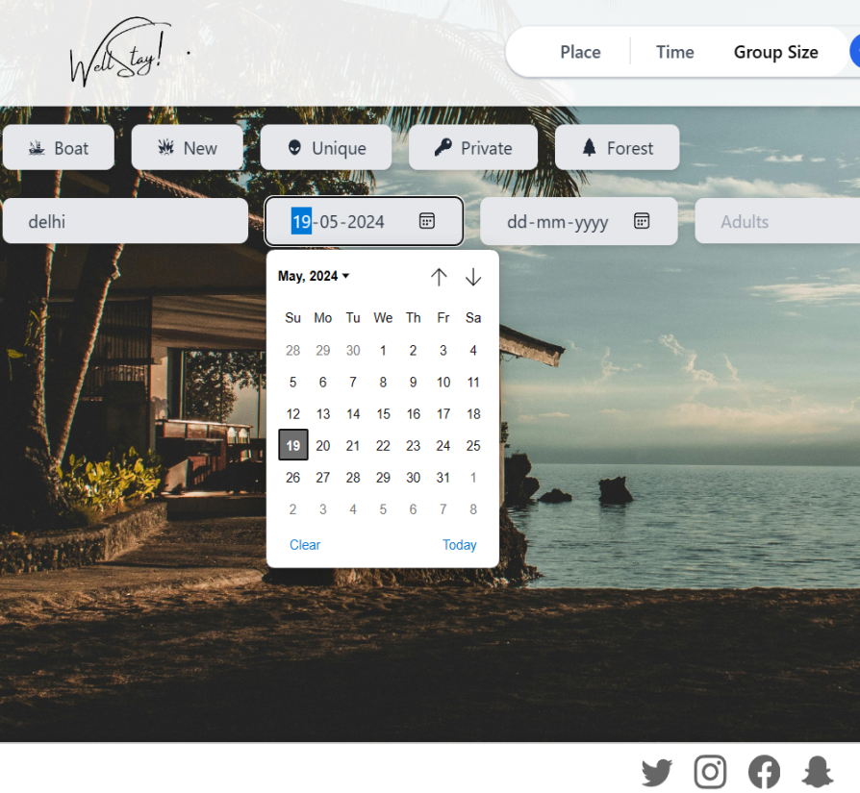
Visuals
Our website offers you homestay based on your number of stays. Calendar visuals and add ease and charm.

Slide 5
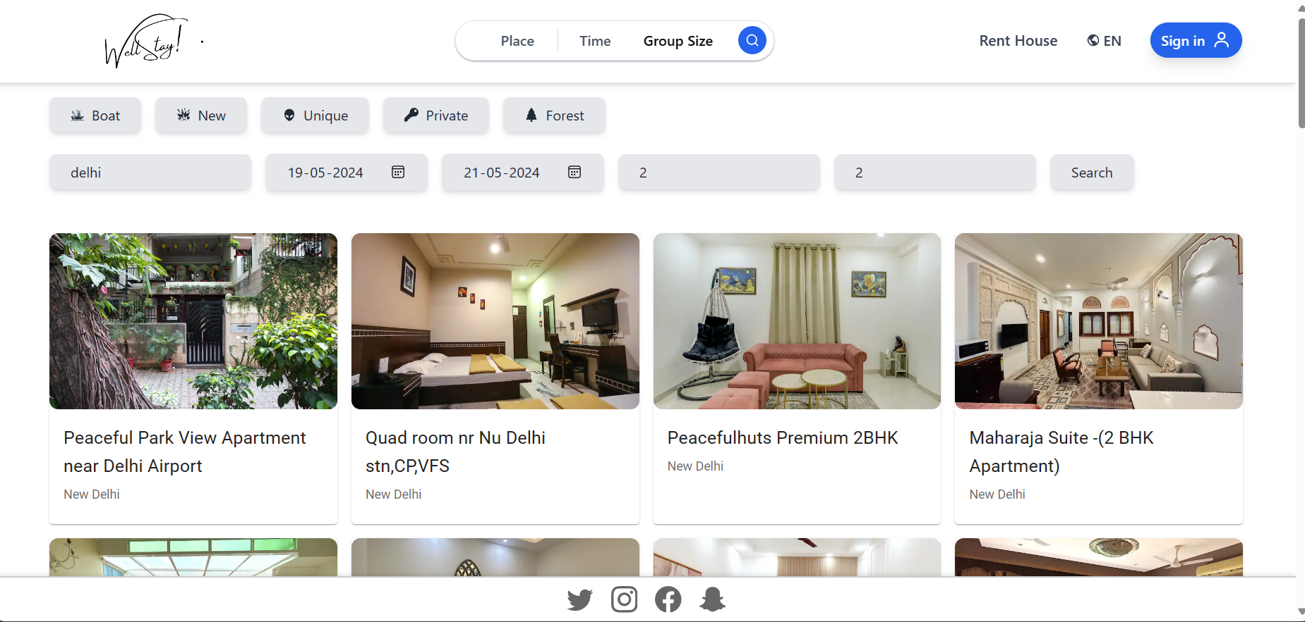
Visuals
Cards rendering the fetched results in a clean, easily interpretable form.

Slide 6
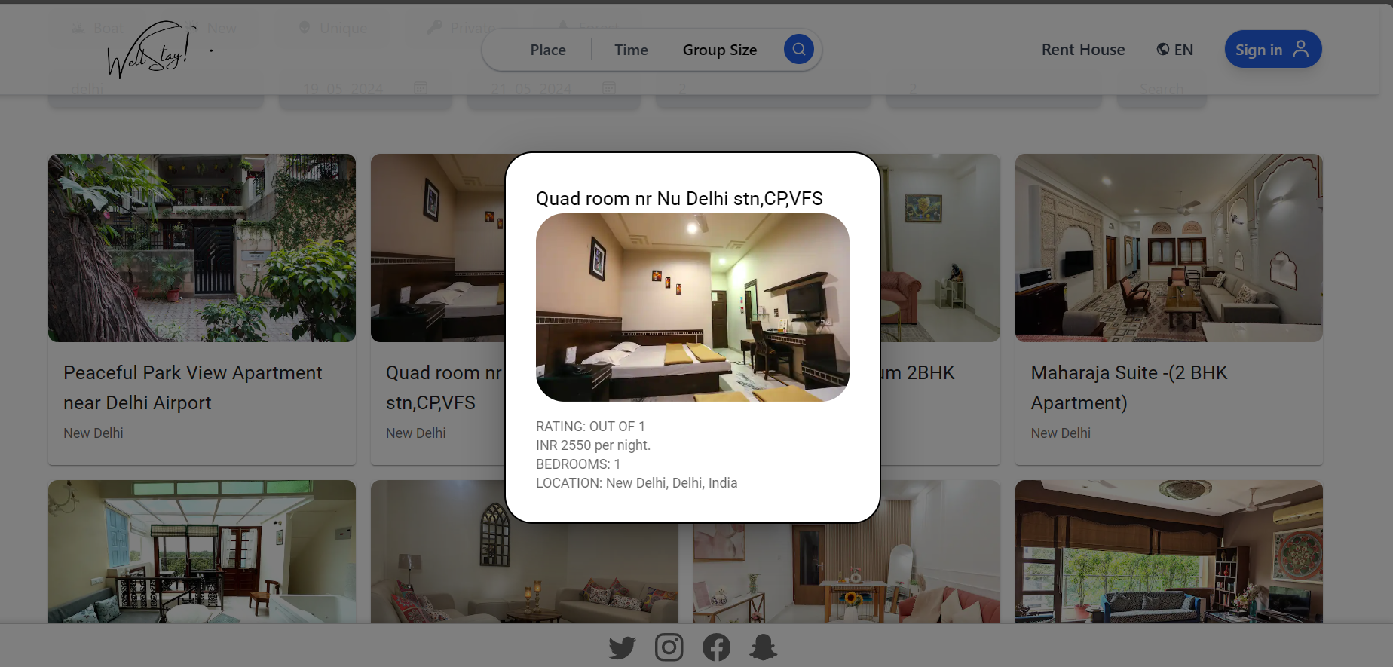
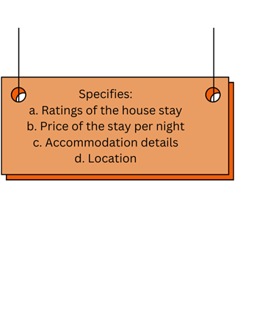
Visuals
Cards rendering the fetched result in clean easily interpretable form.

Slide 7
Features
Search and Discovery: Guests can search for accommodations based on location, dates, price range, amenities, and other filters to find the perfect place to stay.
2) Reviews and Ratings: Guests can leave reviews and ratings after each stay, which helps build trust within the Airbnb community and ensures quality experiences.
3) Providing comprehensive information such as the quantity of bedrooms, bathrooms, kitchen facilities, and other pertinent details.
4) Guests can utilize the feature for specifying their arrival and departure dates.
5) Displaying all the particulars regarding expenses..

